Slide 1
<COURSE_TITLE>
Version: 10.0
Trainer: ________________
Course Code: <TGS_REF_NO>
Website: www.tertiarycourses.com.sg
Email: enquiry@tertiaryinfotech.com
Tel: +65 6100 0613

Slide 2
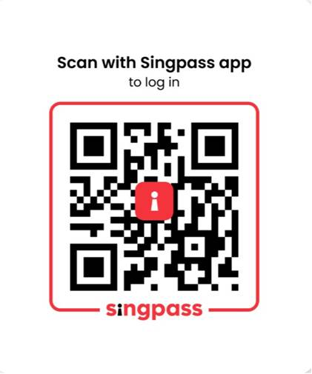
Digital Attendance
It is mandatory for you to take both AM and PM digital attendance especially for WSQ courses.
The trainer or administrator will show you the digital attendance QR code generated from TPG.
Please scan the QR code from your Singpass App and submit your attendance.

Slide 3

About the Trainer
Please add the following info to this page
Screenshot of your LInkedin Profile (with profile image)
QR code to your Linkedin
Certifications eg PL-100, AWS, CISA….
Sample below

Slide 4

Let's Know Each Other...

Slide 5
Ground Rules
Set your mobile phone to silent mode
Actively participate in the class. No question is stupid.
Respect each other view
Exit the class silently if you need to step out for phone call, toilet break

Slide 6
Lesson Plan
Day 1
Digital Attendance (AM)
Trainer and Learners Introduction
Learning Outcomes
Course Outline
Topic 1: ….
Lunch Break
Digital Attendance (PM)
Topic 2: ….
End of Day 1

Slide 7
Lesson Plan
Day 2
Digital Attendance (AM)
Topic 3 …
Lunch Break
Digital Attendance (PM)
Revision
Digital Attendance (Assessment)
Final Assessment
Course Feedback and TRAQOM Survey
End of Class

Slide 8
Skills Framework
TSC Title: <TSC_TITLE>
TSC Code: <TSC_CODE>
Notes:
http://www.tkdocs.com/tutorial/install.html#installwin

Slide 9
Skills Framework TSC
TSC Abilities:
<ABILITIES>
TSC Knowledge:
<KNOWLEDGE>
Notes:
http://www.tkdocs.com/tutorial/install.html#installwin

Slide 10
Learning Outcomes
By the end of the course, learners will be able to:
<LEARNING_OUTCOMES>

Slide 11
Course Outline
<COURSE_OUTLINE>

Slide 12
Final Assessment
<ASSESSMENT_METHODS>

Slide 13
Access Google Classroom LMS
You can access more resources from Google classroom LMS
https://classroom.google.com/c/NjcyMjU4NzA1OTgz?cjc=ipnbph2
Alternatively. You can goto https://classroom.google.com and enter the class code on the top right.
Google Class code: ipnbph2

Slide 14

CERTIFICATE
Two e-certificates will be awarded to trainees who have demonstrated competency in the WSQ assessment and achieved at least 75% attendance.
A SkillsFuture WSQ Statement of Attainment (SOA) issued by WSG. Typically take 4 weeks
Certification of Completion issued by Tertiary Infotech Pte Ltd, immediately after the course
Notes:
14

Slide 15
<TOPICS_OUTLINE>

Slide 16
Summary
Q&A

Slide 17
Digital Attendance
It is mandatory for you to take both AM and PM digital attendance especially for WSQ courses.
The trainer or administrator will show you the digital attendance QR code generated from TPG.
Please scan the QR code from your Singpass App and submit your attendance.

Slide 18
Final
Assessment
Notes:
Assessor Guide:
Request the access to
https://colab.research.google.com/drive/1Z3GWKczCULhG6Gd86vvYbykwCqjcUIn9?usp=sharing

Slide 19
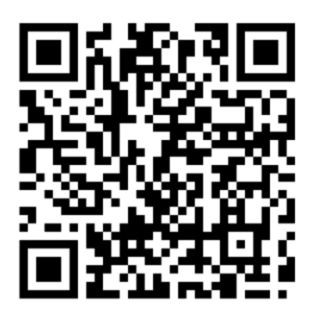
TRAQOM Survey
Access the survey here
Key in your Last four NRIC/FIN characters and the Six-digit course run ID to complete the survey

Slide 20
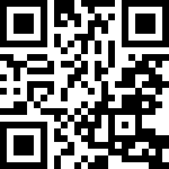
Feedback
Kindly submit your course feedback below
https://goo.gl/R2eumq

Slide 21
Support
If you have any enquiries during and after the class, you can contact us below
Email: enquiry@tertiaryinfotech.com
Tel: 61000613
Whatsapp: 61000613

Slide 22
Thank You!

